Slide 1
An Inductive-Capacitive (LC) Sensor for Real-time Biofilm Growth Monitoring
Ekaterina Tolstaya
Young Kim

Slide 2
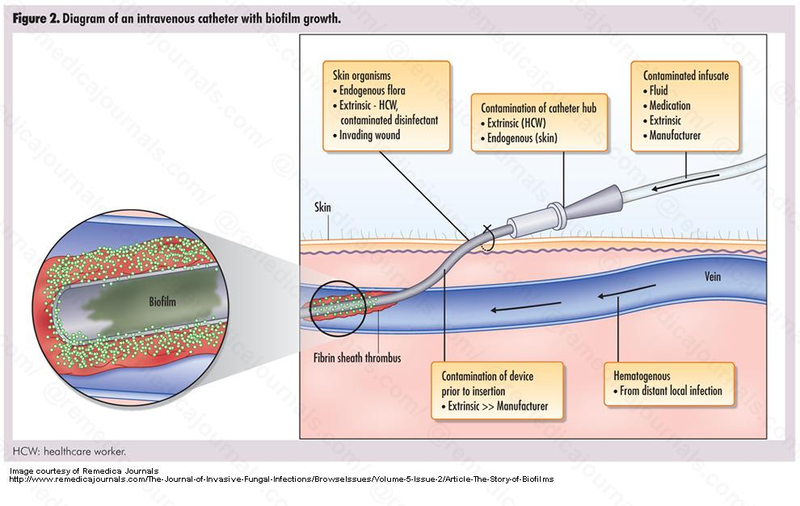
Biofilm Sensing
Medical biofilms
Cause diseases, often requiring surgery or antibiotics at does 1000 times great than for non-biofilm infections
Biofilms forming in catheters can cause infections in patients
Environmental biofilms require cleaning with harsh chemicals
Biofilm formation on the solid surfaces of the catheter within the body of the patient.

Slide 3
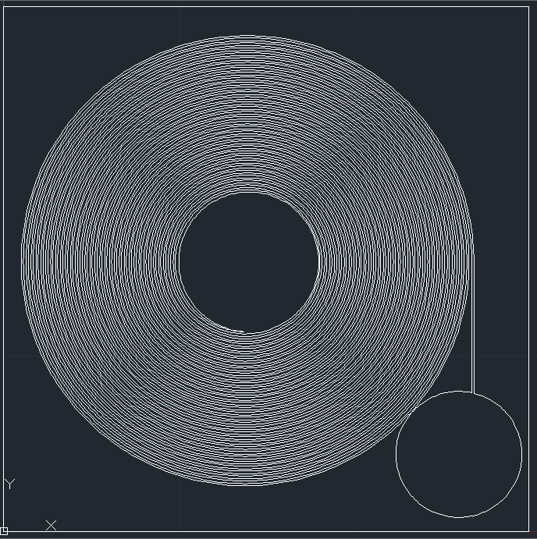
Why Inductance - Capacitance Sensing?
Ultimate Goal – Flexible biofilm sensor inside of a catheter
Young’s SAW sensor cannot be used on flexible substrate due to changes in piezoelectric coefficient
Further work – Wireless integration using inductive coupling
Ease of fabrication
2 steps vs. 7 steps for SAW sensor
No piezoelectric material deposition (ZnO)
Photolithography mask for the LC sensor

Slide 4
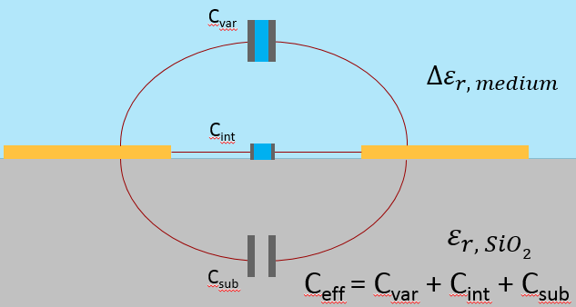
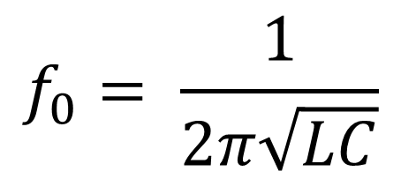
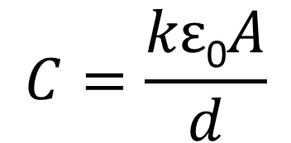
Principles and Design of the LC Sensor
Biofilm Growth
Permittivity Constant Change
Capacitance Change
Resonance Freq. Change
Parameters
Device radius
Electrode thickness
Electrode gap
Electrode width
Considerations
Increase sensitivity
Keep resonance frequency within measurable range
Ease fabrication
$$f_{0}= \frac{1}{2π\sqrt{LC}}$$
$$C=\frac{kε\text{0}A}{d}$$
The capacitance of the sensor depends on the permittivity constants of the medium and SiO₂.

Slide 5
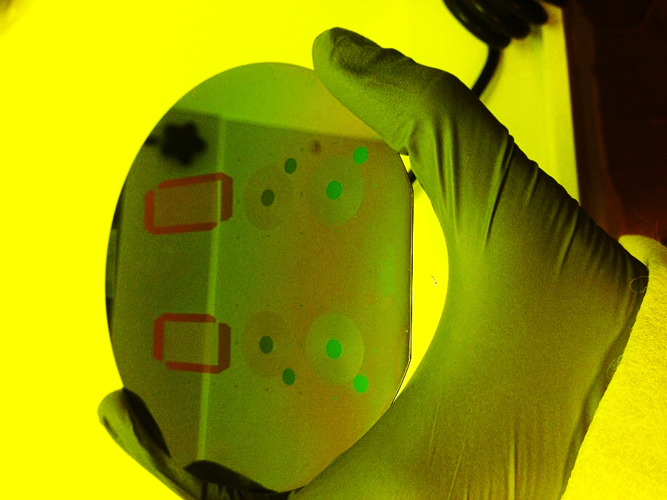
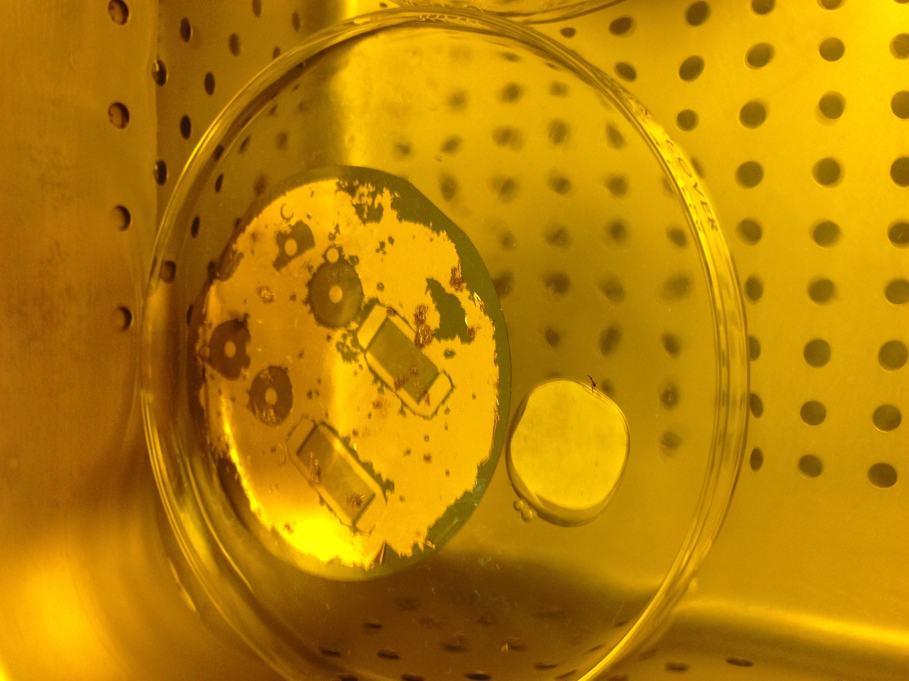
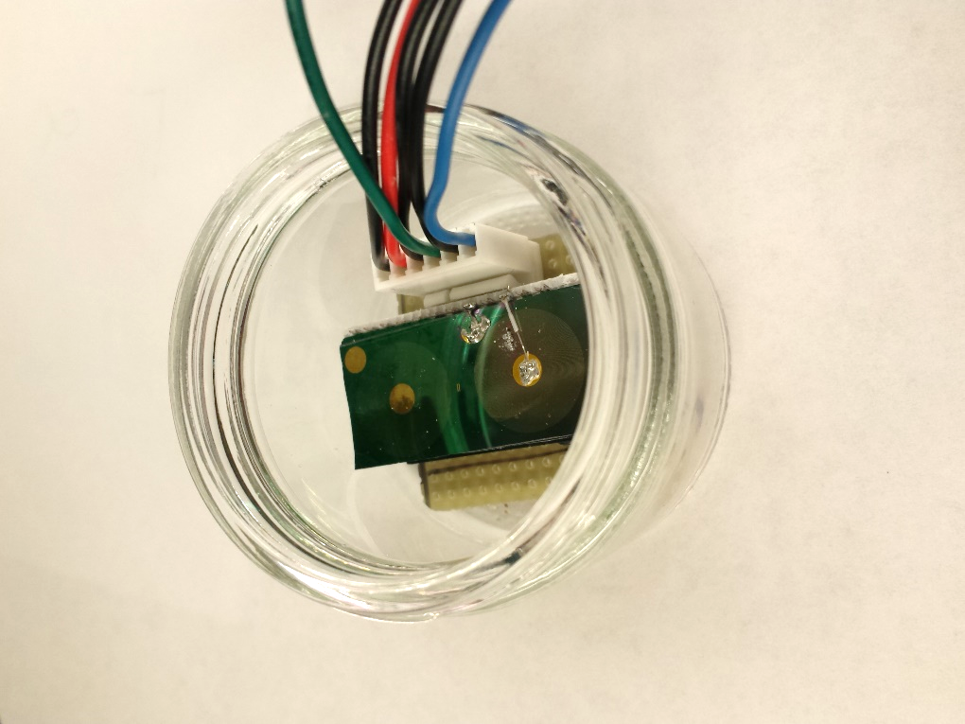
My Role
Simulations
Mask design
Automated of drawing spirals in AutoCAD
Fabrication
Learned photolithography, lift-off, inspection of device
Test setup
Designed a modular system to ease cleaning and containment of bacteria
Experiments
Confirmed device operation
Conducted biofilm experiments
Developed negative resist
Lift-off process
Assembled test setup and sensor

Slide 6
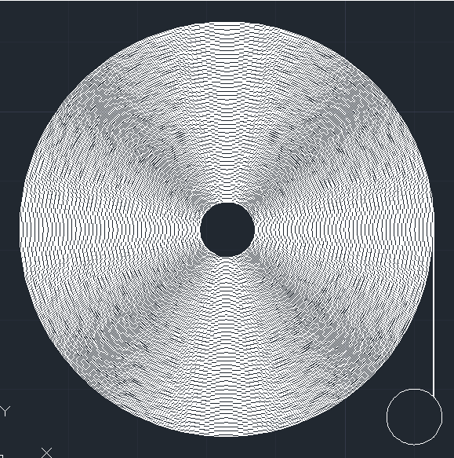
Device Parameters
Device | Radius | Electrode Width | Electrode Gap | Inductance | Capacitance | Simulated Resonance Freq. in Water | Actual Resonance Freq. in Water
Small | 0.65 cm | 60 um | 80 um | 0.43nH | 1.2nF | 221.56MHz | 136 MHz
Large | 1.5 cm | 60 um | 80 um | 8.57nH | 8.77nF | 18.36MHz | 14.7 MHz
400 um
800 um
Photolithography masks for the large and small LC sensors

Slide 7
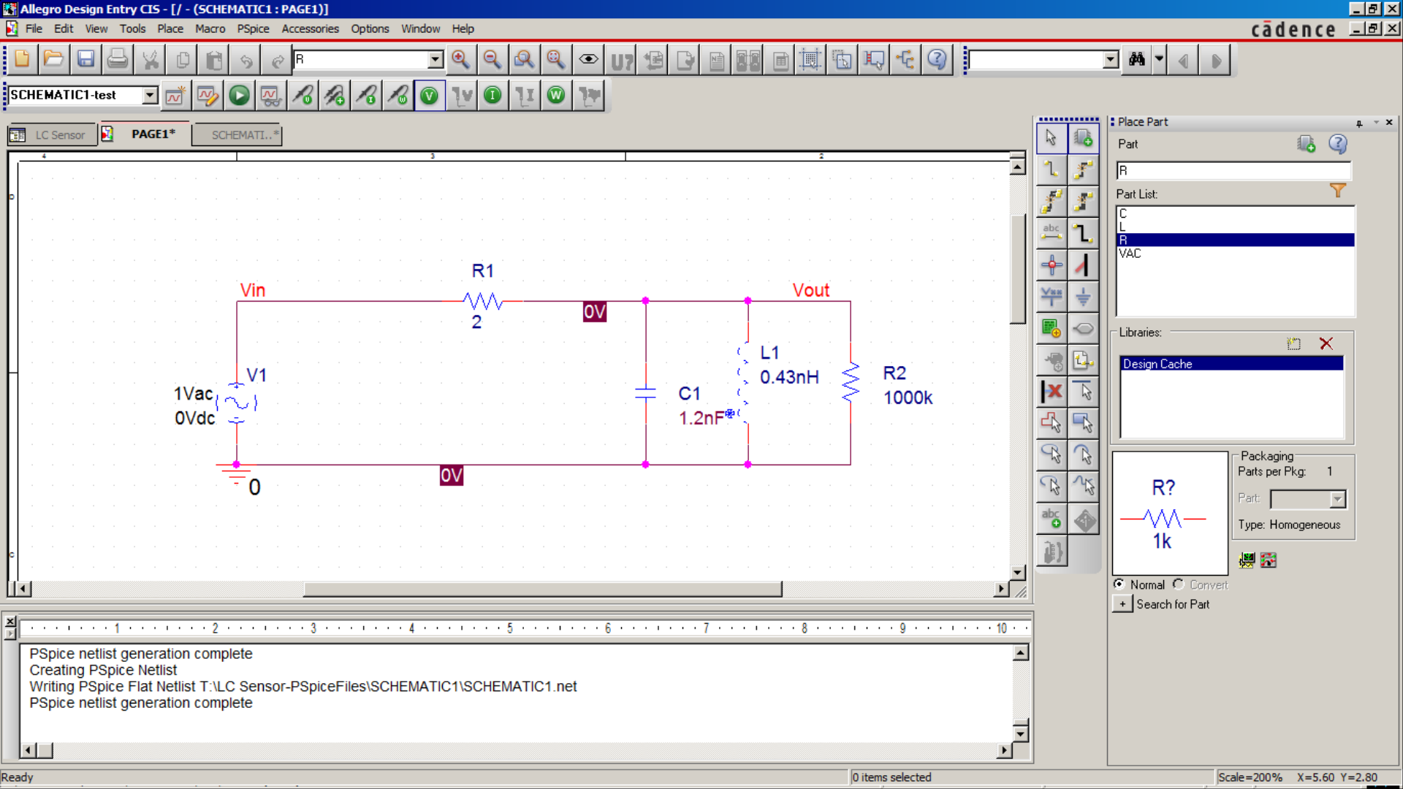
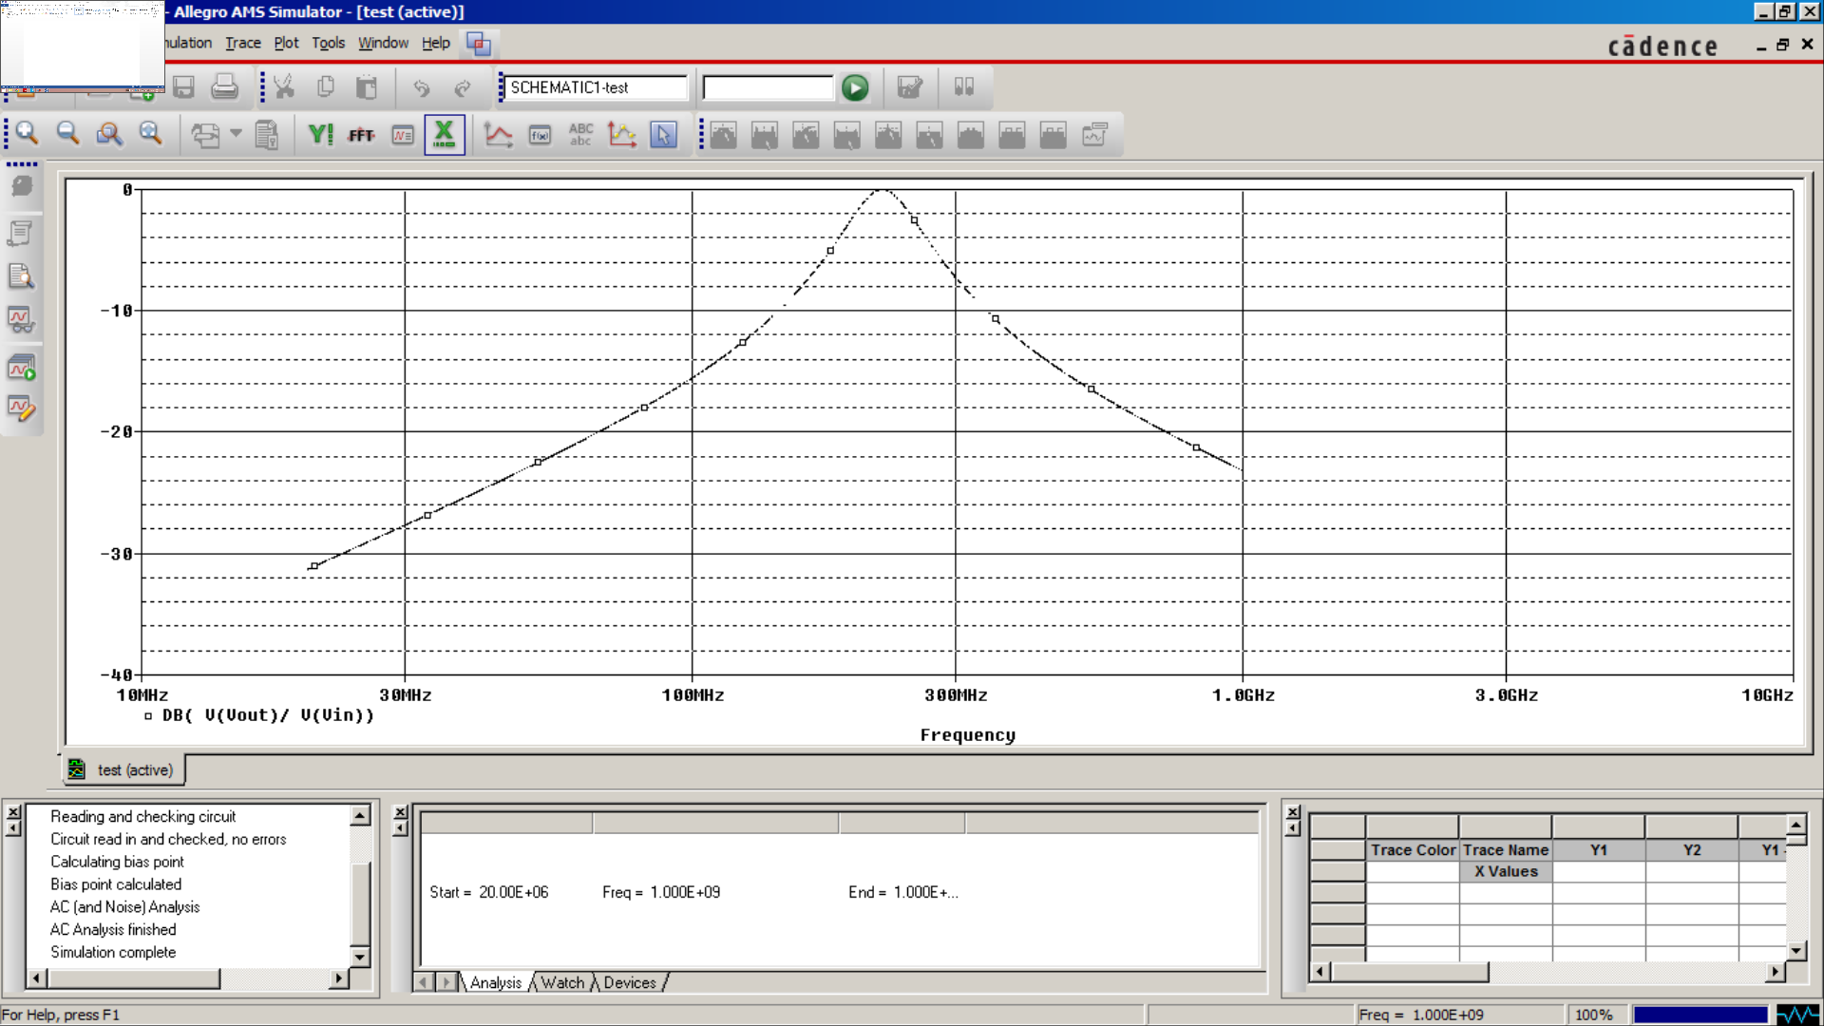
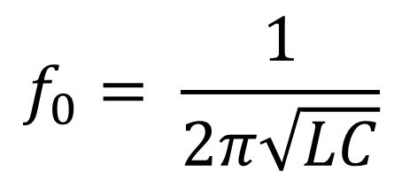
Circuit Simulation
Matlab parameter simulation:
Capacitance = 1.2 nF
Inductance = 0.43 nH
Large load resistance due to instrument impedance
PSPICE circuit simulation:
Circuit will act as a band-pass filter, with a resonance frequency of 221.3 MHz
$$f_{0}= \frac{1}{2π\sqrt{LC}}$$
LC Sensor simulated in PSPICE as an parallel LC circuit

Slide 8
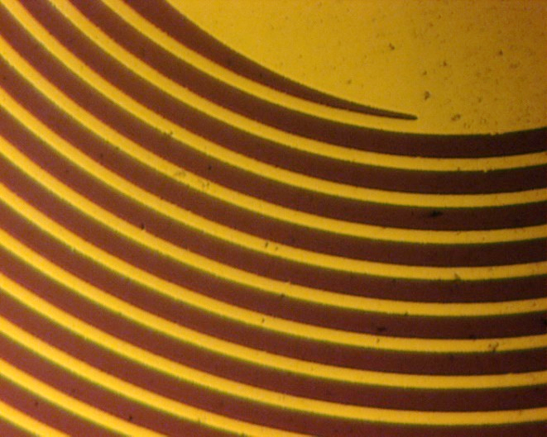
Device Fabrication
Silicon Oxide using PECVD
200 um
Negative Resist
[Image reversible]
AZ5214
Microscope photo of the coils of a fabricated sensor
Cr/Au
(15 nm/200nm)
By E-Beam Evaporation
Lift-off
100 um
Photolithography mask for the LC sensor
Notes:
SCALE BARS

Slide 9
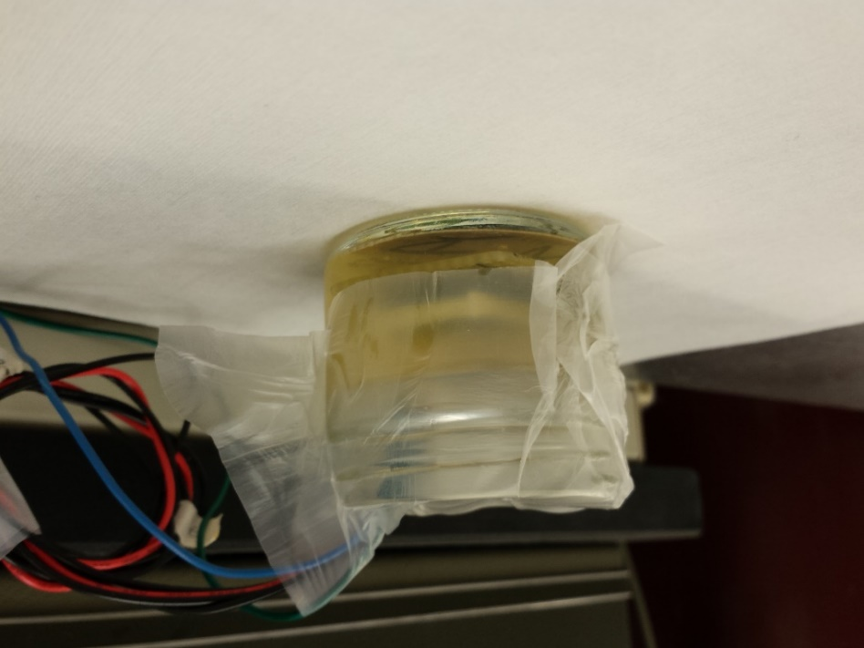
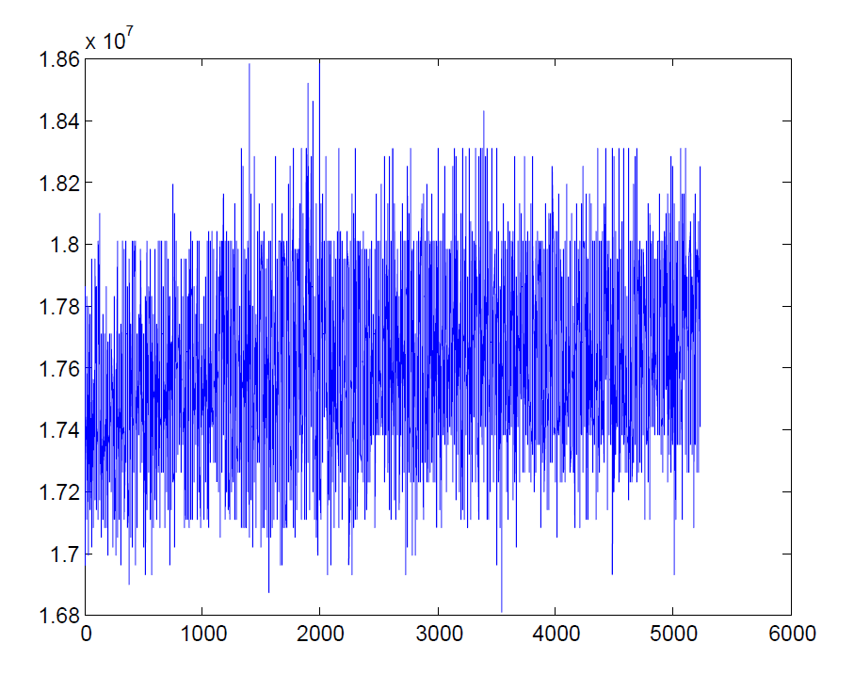
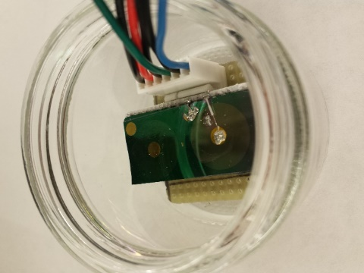
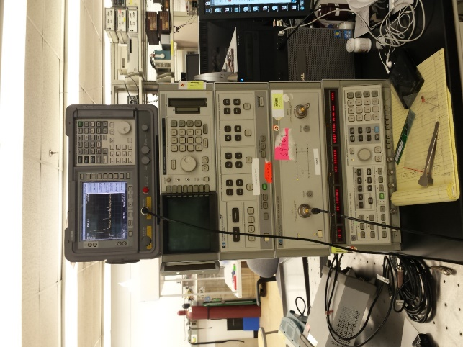
Test Procedure and Equipment
Test setup - modular, reusable and resistive to bleach clean, with a 80 mL volume
Escherichia coli W3110 in LB media
Network analyzer as frequency sweeper and spectrum analyzer to analyze frequency response
Device interface is controlled through GPIB by C code
1)
2)
3)
4)
Frequency
Time

Slide 10
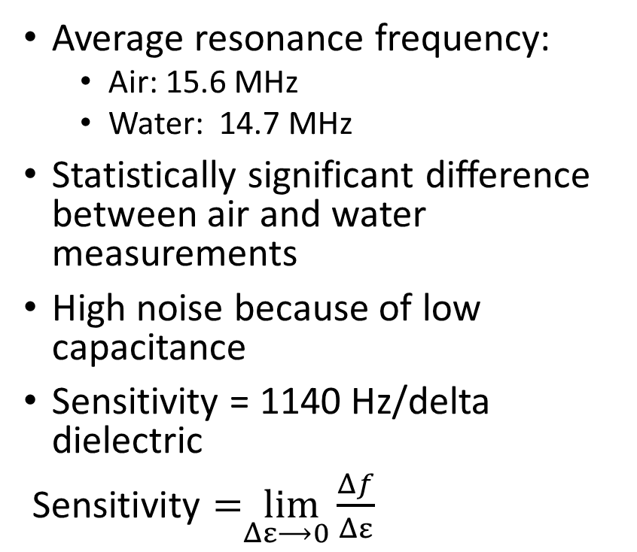
Characterizing Device Sensitivity
Average resonance frequency:
Air: 15.6 MHz
Water: 14.7 MHz
Statistically significant difference between air and water measurements
High noise because of low capacitance
Sensitivity = 1140 Hz/delta dielectric
$\text{Sensitivity}=\lim_{Δε⟶0}{\frac{Δf}{Δε}}$

Slide 11
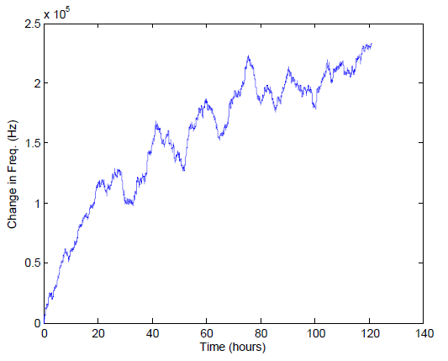
Sensing Biofilm Growth
Frequency observed to increase by 0.25 MHz as biofilm grows
Consistent with literature
Water permittivity: ~80
Biofilm permittivity: ~60
Filtered to reduce noise
Moving average of 400 samples

Slide 12
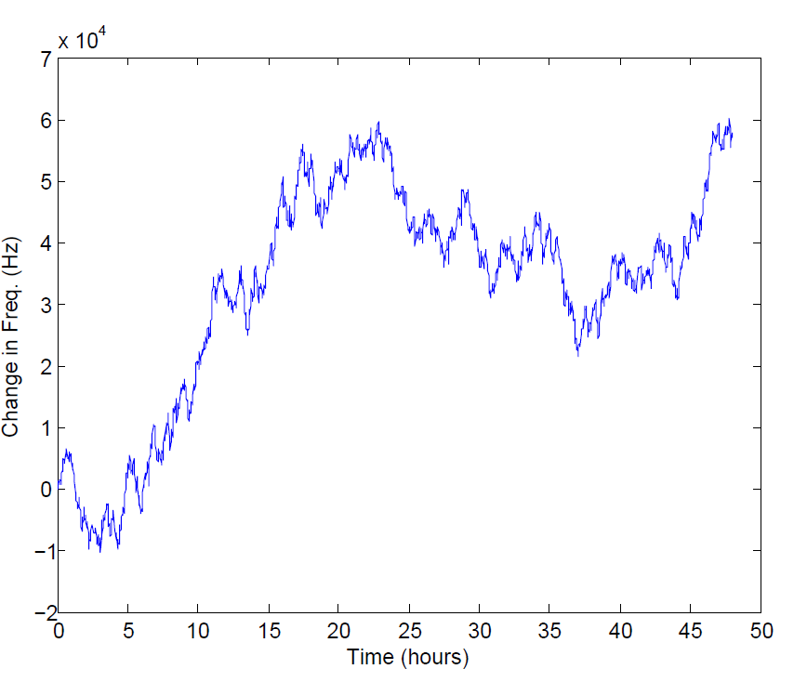
Additional Biofilm Experiment
Different device
Shorter time frame
Same filtering method

Slide 13
Future Experiment Ideas
Determining actual change in permittivity during biofilm growth
Imaging biofilm on sensor after biofilm experiments
Summarizing simulation data
Simulating change in capacitance over time – PSPICE, Matlab
Characterizing permittivity change by drying biofilm on sensor
Compare permittivity for dry clean sensor and sensor covered in dry biofilm

